Slide 1
Personality temperament type
Java 035_01
03.05.2023.

Slide 2
Use Case
The project is based on temperament type calculation by personality temperament test. Person need answer 4 sections of questions and evaluate herself from 1 to 5:
1 = “That is definitely NOT me”;
2 = “That is usually NOT me”;
3= “That is usually me”;
4 = “That is mostly me”;
5 = “That is totally me.”
The result is calculated based on the entered answers. The answer will be Sanguine Temperament, Choleric Temperament, Melancholy Temperament, Phlegmatic Temperament.
Persona need to login to fill the test.
GitHub repository:
https://github.com/AnaSmolakova/group4_SGT

Slide 3
Our team:
01
02
03
04
All together: develop the idea, structure methods, and data, and look for bugs, testing.
Anastasija Smoļakova
Marina Dzjubenko
Viktorija Lietuvnike
Responsibilities:
Team Leader,
Creating of metods,
Question database creating,
Responsibilities:
Creating login database,
creating of methods,
Responsibilities:
Creating of result storing database, creating of methods
Baiba Pļaviņa
Responsibilities:
creating of methods, workflows chart, presentation, readme.

Slide 4
Chalanges and Oportunities
Cover the scope of the work (set works and divide reponsibilities)
Organizational cooperation (slack, whatapp, zoom)
Data exchange (githab.com)
Coding
We agreed on a Project:
Help each other and work as a TEAM;
Learn new skills;

Slide 5
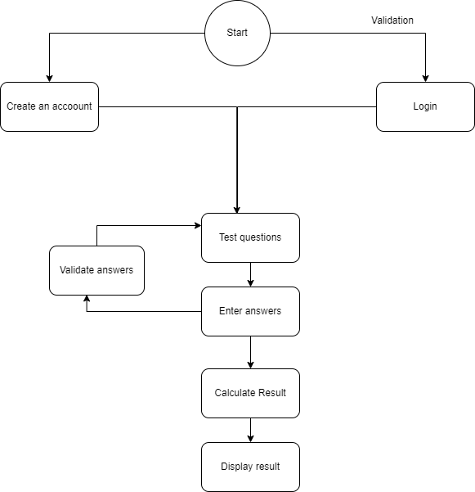
Flow diagram - Testing process
www.app.diagrams.net

Slide 6
DataBase diagramms
psychology test questions database (table: psychologytest)
Users (table: loginInfo)
answers database (table: testResults)
userID | Integer, primary key, Auto_increment
password | Varchar, NOT NULL
fullName | Varchar, NOT NULL,
username | Varchar, NOT NULL
email | varchar
questionID | Integer, primary key, NOT NULL, auto_increment
section | Integer, NOT NULL
question | Varchar, NOT NULL
userID | Integer, NOT NULL, FOREIGN KEY, REFERENCES loginInfo(userID), answerID (primary key)
choleric | INT NOT NULL
sanguine | INT NOT NULL
melancholic | INT NOT NULL
phlegmatic | INT NOT NULL

Slide 7
Testing results &
Code validate login and after creating account it is not necessary to log in again. Test starts immediately.
improvements
reading results of already filled test after login;
date and time of test completion;

Slide 8
THANK YOU for your attentioon!
Do you have any questions?

